Slide 1
Human Resource Management

Slide 2
Objectives
Human Resource Management
Why do people work?
What power does a Project Manager have?
How are people motivated?
How can teams be managed?

Slide 3
Human Resource Management
Making effective use of the people involved with a project.
Four Processes:
  Human Resources Planning
    Identify and list project roles and responsibilities
  Acquiring the project team
    Getting the right people assigned to the project team.
  Developing the project team
    Building individual and group skills to enhance project performance.
  Managing the project team
    Tracking team member performance, motivating team members, providing timely feedback, resolving issues and conflicts, and coordinating changes to enhance project performance

Slide 4
Why people work
To manage people, we need to understand why they work for us in the first place.
Why do people work?
What do they need so they can work better?
Much research by psychologists and management theorists have been devoted to the field of managing people at work. Important areas related to project management include:
  Motivation theories
  Influence and power
  Effectiveness

Slide 5
Maslow’s Hierarchy of Needs
Abraham Maslow suggested that human beings possess unique qualities that enable them to make independent choices, thus giving them control over their destiny.
He developed a hierarchy of needs, which states that people’s behaviors are guided or motivated by a sequence of needs.
These needs are arranged in layers. Bottom layer needs must be met before people are concerned with the next layer above.

Slide 6
high
Challenging projects,
opportunities for
innovation and creativity
5. Self
Actualization
Recognition,
prestige, status
4. Esteem
Acceptance, love,
Affection, Association
with a team/group
3. Social
Physical safety
Economic
security
2. Safety
Food,
Water,
etc
1. Physiological
low
A satisfied need is no longer a motivator

Slide 7
Herzberg’s Motivational and Hygiene factors
Frederick Herzberg wrote in the area of worker motivation. He distinguished between:
  Motivational factors
    Achievement, recognition, the work itself, responsibility, advancement and growth. These factors produce job satisfaction.
  Hygiene factors
    Larger salaries, more supervision and an attractive work environment. These factors cause dissatisfaction if not present, but do not motivate workers to do more.

Slide 8
Herzberg’s Motivational and Hygiene factors
Hygiene factors | Motivational factors
Larger salaries | Achievement
More supervision | Recognition
More attractive work environment | Work itself
Computer or other required equipment | Responsibility
Health benefits | Advancement
Training | Growth

Slide 9
Intrinsic and Extrinsic Motivation
Intrinsic motivation
  Causes people to participate in an activity for their own enjoyment.
Extrinsic motivation
  Causes people to do something for a reward or to avoid a penalty
  Edward L. Deci & Richard M. Ryan – Self Determination Theory

Slide 10
Intrinsic vs. Extrinsic
People are usually attracted to a job for extrinsic reasons (good pay, good benefits, good working conditions)
People usually stay with a job for intrinsic reasons (they like the people they work with, they find the job challenging, people praise them for the work they do)
Paying people more money (extrinsic motivation) does not make them work harder. But it might keep them from leaving and it might attract new employees)
Intrinsic motivation is what builds loyalty and dedication in your employees

Slide 11
McGregor’s Theory X and Theory Y
Douglas McGregor popularized the human relations approach to management (1960s).
  Theory X
    Assumes workers dislike and avoid work, so managers must use coercion, threats and various control schemes to get workers to meet objectives
    Explains the importance of heightened supervision, external rewards and penalties
  Theory Y
    Assumes individuals consider work as natural as play or rest and enjoy the satisfaction or esteem and self-actualization needs
    The motivating role of job satisfaction and encourages workers to approach tasks without direct supervision.
Theory Z
  Introduced in 1981 by William Ouchi, based on the Japanese approach to motivating workers, emphasizing trust, quality, collective decision making, and cultural values.

Slide 12





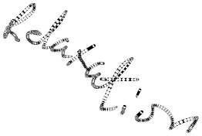
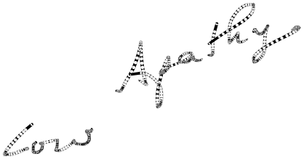

Mihaly Csikszentmihalyi
Flow Theory
Flow: The mental state in which a person performing some activity is fully immersed in a feeling of energized focus, full involvement, and enjoyment in the process of the activity.

Slide 13
The power of a project manager
A project manager must have power to do their job.
Managers must understand the types of power they have
Some power is better to use than others
Power that builds trust, respect and affirms people is best

Slide 14
Types of Power
Power is the potential to influence behavior to get people to do things they otherwise would not do.
Types of power include:
  Coercive
    The ability to gain support through the use of force, threats or fear
  Legitimate
    The ability to claim legitimate power as a reason to earn support. “Do it because I am your boss”
  Expert
    The ability to gain support because of superior knowledge, skills, or understanding of the problem or situation.
  Reward
    Ability to gain support because subordinates perceive someone as being capable or directly or indirectly dispensing valued organizational rewards (e.g. salary adjustments, promotion, bonus, future work assignments, etc)
  Referent
    Ability to gain support because people feel personally attracted to the manager

Slide 15
Thamhain and Wilemon’s ways to have influence on projects
Authority: The legitimate hierarchical right to issue orders.
Assignment: The project manager's perceived ability to influence a worker's later work assignments.
Budget: The project manager's perceived ability to authorize others' use of discretionary funds.
Promotion: The ability to improve a worker's position.
Money: The ability to increase a worker's pay and benefits.
Penalty: The project manager's ability to cause punishment.
Work challenge: The ability to assign work that capitalizes on a worker's enjoyment of doing a particular task.
Expertise: The project manager's perceived special knowledge that others deem important.
Friendship: The ability to establish friendly personal relationships between the project manager and others.

Slide 16
Using Power for Success
Projects are more likely to succeed when project managers influence people using:
  Expertise
  Work challenge
Projects are more likely to fail when project managers rely too heavily on:
  Authority
  Money
  Penalty

Slide 17
Human Resource Planning
Involves identifying and documenting project roles, responsibilities, and reporting relationships
Outputs include:
  Project organization charts
  Staffing management plan
  Responsibility assignment matrices
  Resource histograms

Slide 18
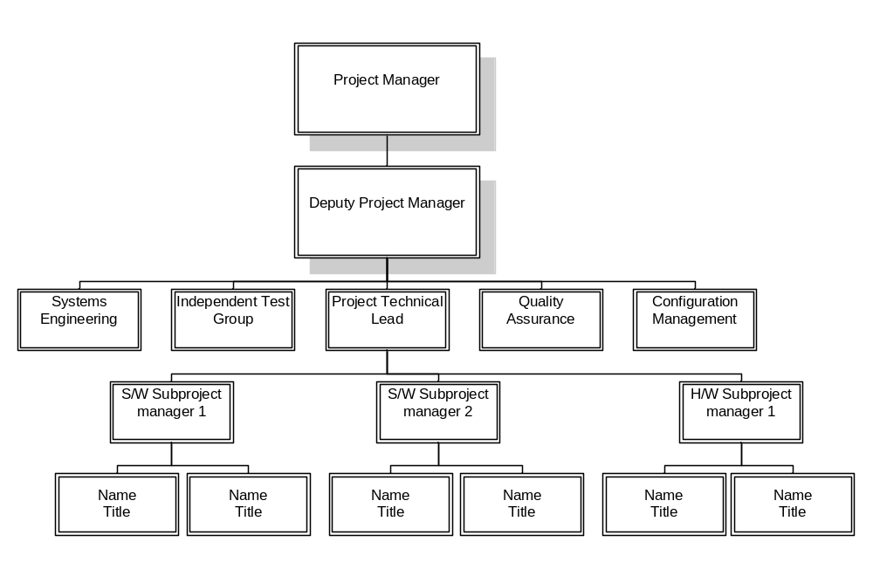
Sample Organization Chart

Slide 19
Responsibility Assignment Matrices
A responsibility assignment matrix (RAM) is a matrix that maps the work of the project as described in the work breakdown structure to the people responsible for performing the work.
It can be created in various ways to meet unique project needs.

Slide 20
Sample RAM
Tasks | Subtasks | SE | HA | SA | TR | User
A | System Design
A1 | Define work process | X |  |  |  | X
A2 | Identify required information and sources | X |  |  |  | X
A3 | Design software system to support work process
A31 | Basic software | X
A32 | Data access required | X |  |  |  | X
A33 | Vendor software required | X |  |  |  | X
A4 | Identify required hardware components | X |  |  |  | X
A0 | System design milestone | X |  |  |  | X
Key: SE System engineer personnel
HA Hardware acquisition
SA Software acquisition
TR Trainer

Slide 21
Staffing Management Plans
A staffing management plan describes when and how people will be added to and taken off the project team.
A resource histogram is a stacked column chart that shows the number of resources assigned to a project over time.

Slide 22
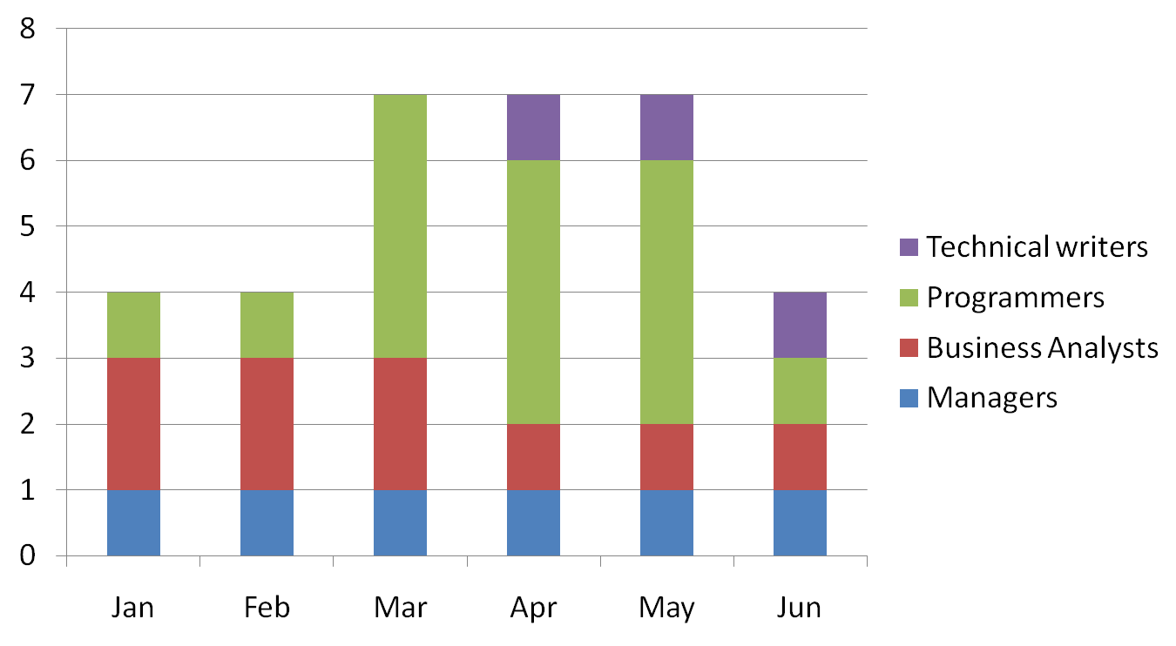
Sample Resource Histogram

Slide 23
Acquiring the project team
Acquiring qualified people for teams is crucial.
Staffing plans and good hiring procedures are important, as are incentives for recruiting and retention.
Why people leave their jobs
  They feel that they do not make a difference
  They do not get proper recognition
  They are not learning anything new or growing as a person
  They do not like their coworkers
  They want to earn more money

Slide 24
Training
Training can help people understand themselves and each other, and understand how to work better in teams.
Team building activities include:
  Physical challenges
  Psychological preference indicator tools

